Slide 1
Fintech Hackathon
Customer engagement with Bots
by,
SOURAB B R

Slide 2

Most of the chat bots trained and deployed are sequence to sequence model types, which require tons of data to be trained accurately and takes a lot of time to train and also are inaccurate sometimes. This chat bot of mine is domain specific bot which is an end to end model.
Domain specific chat bots are becoming a reality! Using deep learning chat bots can “learn” about the topic provided to it and then be able to answer questions related to it. The applications of a technology like this are endless. You just provide data about a topic and watch the bot become an expert at it. Given any financial data, the bot will learn the trends in the data and will be able to reply to any queries of the customers regarding that data.
Uniqueness:

Slide 3
The online services provided by many of the companies require someone to reply to the queries of the customers and also as to act as a guide regarding the service or product being delivered by the company to the customers. As the number of customers increases it becomes very difficult for the human representative of the company to process the requests efficiently and also it becomes very time consuming. In case of financial data any request has to be overseen by the representative and has to understand the present trend in the market and then provide the solution to the customer.
Having a bot which can train itself and become an expert on any given information makes it easy for the company to reply to the problems or queries of the clients and also it becomes a means of automation of the product being delivered by the company.
Problem being solved

Slide 4
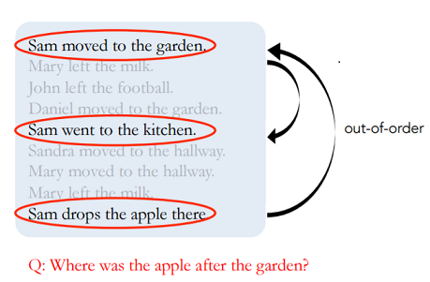
For this problem we use an end to end memory network which was designed by Facebook AI Research. Lets first discuss why a recurrent neural network with LSTM cells won’t work well for this problem.
Data may have to be accessed out of order
Technical architecture

Slide 5
2. We need a long term memory if we want to network to “memorize” a book or a video and LSTM cells practically don’t work for long term memory problems.
The end to end memory networks use an external memory to solve this problem. And it can perform multiple look ups(hops) in the data to solve for out of order data problem.
This model has two modules — a memory module and a controller module. The memory module has the story we want to tell written as vectors. Since computers cannot understand words, we need to convert words into numbers/vectors. Instead of just converting every word to a number, we use a technique called embedding which gives words with similar meanings similar vectors. For example since the words “pick up” or “lift” have similar meaning they will have similar vectors and it helps the machine better understand the context between words. Tensorflow embeddings functionality can be used for generating word to vectors.

Slide 6
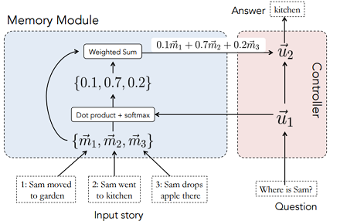
The controller module has the question that is being asked written as a vector.
We then do a dot product of the controller function and the memory vectors. And after that we do a softmax which scales the total probability to 1. And this is passed back to the controller. In the example above, since this neural network takes into account the order of sentences, it gives higher weight-age to the second sentence. We can think of the resulting probabilities (0.1,0.7, 02 above) as implying which vector is the network paying “attention” to.
This process can be repeated several times (also called hops) and the controller has the ability to learn and re look at the memory vectors and make a choice again. See below how the network focuses on different vectors during hops by building on what is has learned in the previous hop.Finally the input is passed to a decoder and the vectors and converted to words.

Slide 7
Tensorflow framework for creating the end to end model.
Keras framework which sits on top of tensorflow and is used here for created the input, hidden and output layers of the recurrent neural network.
Facebook graph api and reddit pawn api was used to collect parent and child comments to test out the sequence to sequence model.
The bAbi dataset of facebook on which the algorithm was initially tested.
AWS-EC2 instance to train the data.
Node js for server side scripting.
Technology/Tool

Slide 8
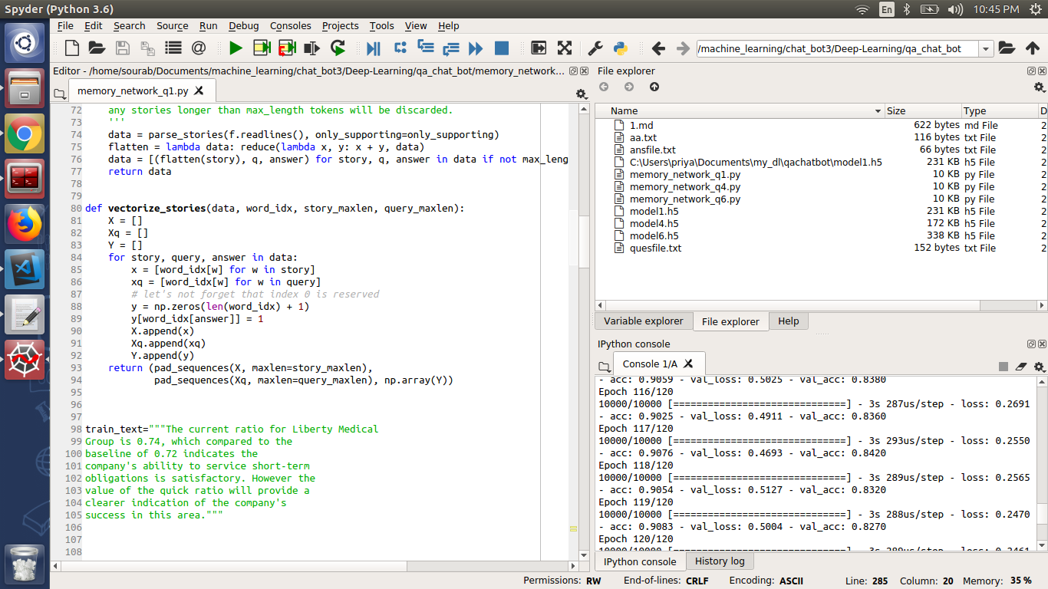
The algorithm is trained on the financial data on the left side of the image. The training of the algorithm is shown to the right side of the image.
Prototype Demo(Video/Screenshots)

Slide 9
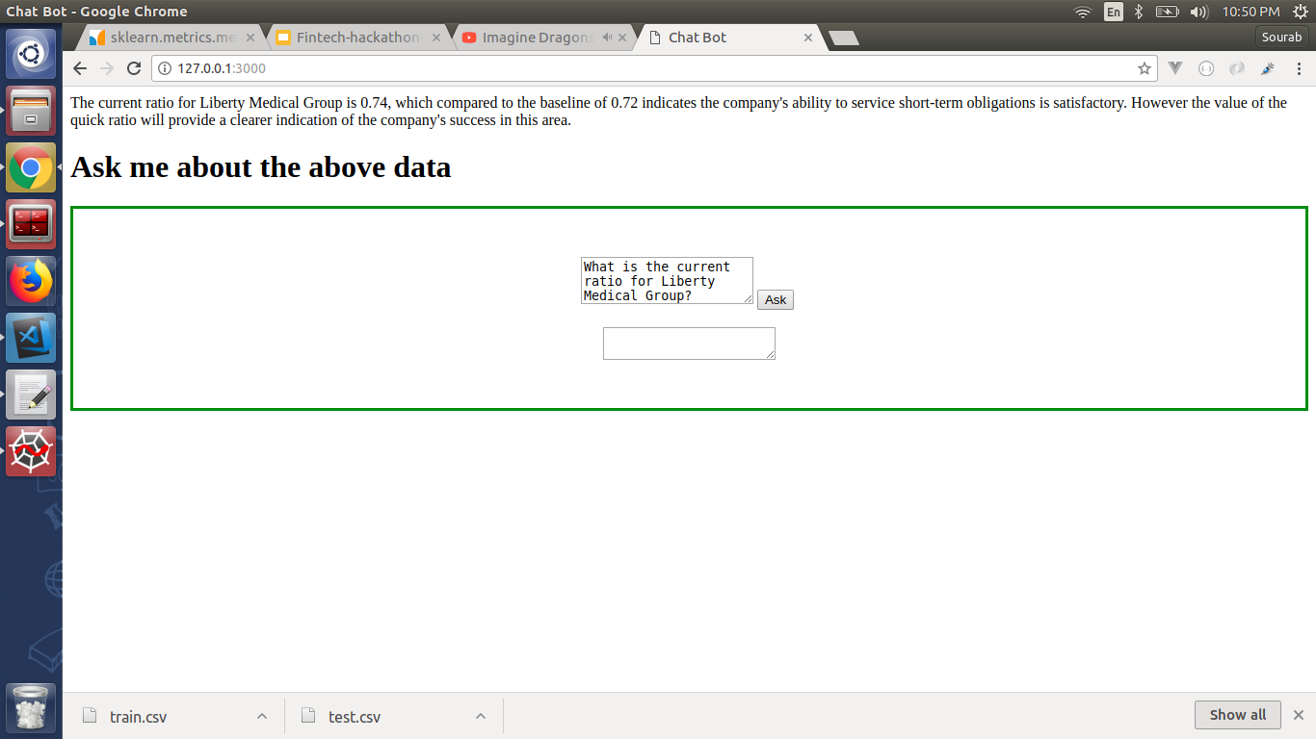
2. This is the web app for the bot. The bot is trained on this data. A question is asked regarding the same data.
Prototype Demo(Video/Screenshots)

Slide 10

3. The answer predicted by the bot is shown in this screenshot which is correct!
Prototype Demo(Video/Screenshots)

Slide 11

4. Another question is asked to the bot.
Prototype Demo(Video/Screenshots)

Slide 12
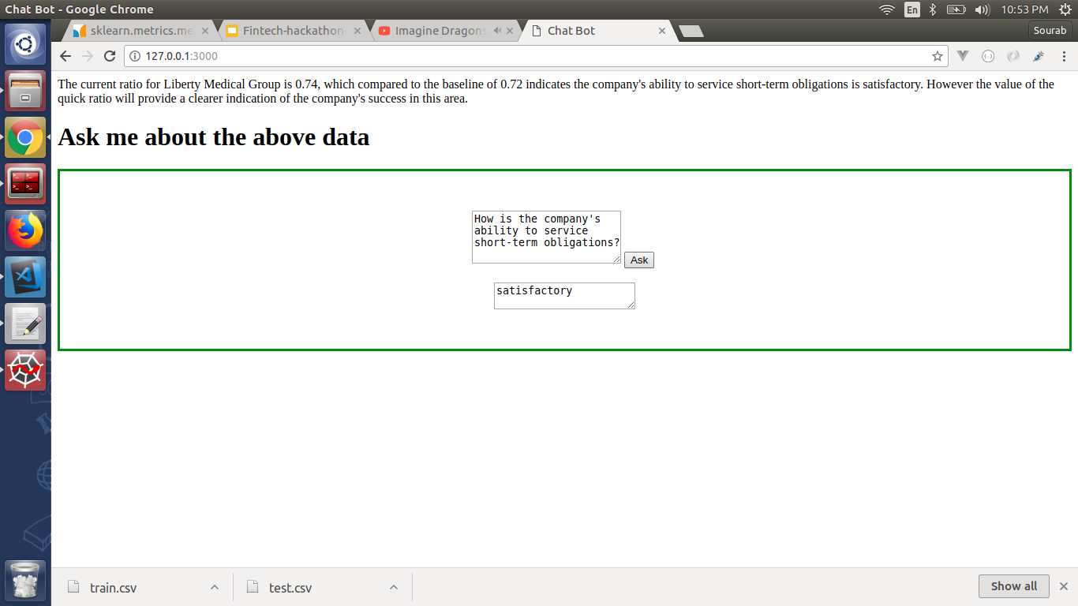
5. This is the predicted answer to the previously asked question.
Prototype Demo(Video/Screenshots)

Slide 13
The bot was first implemented using sequence to sequence model which required tons of data and took 4 days on aws-ec2 instance to train.
The sequence to sequence model used LSTMs (Long Short Term Memory ) units which couldnt keep track of what was spoken before 5 to 6 conversations.
Implementation of end to end model of tensorflow which included encoding and decoding the sentences to get the vector representation of the sentence.
Structuring the new data in the form of bAbi dataset (developed by facebook AI team).
Challenges faced

Slide 14
Possible Improvement
Reducing the training time
01
The model is trained for 120 epochs which yields around 95% accureacy which takes around 5 minutes to train in an intel core i5 CPU. The model can be trained on GPU to improve and reduce the training time.
Trying on different stucture of data
02
The data for the algorithm to be trained is to be a paragraph of text. The algorithm can be improved to preprocess and understand even tabular and image data.

Slide 15


